Slide 1
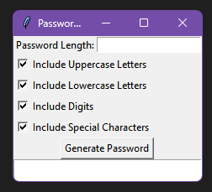
Password Generator Secure Your Digital Life: Custom Passwords https://github.com/ksu-is/Password-Generator-Project/tree/main
Andrew Light

